Slide 1
mydlink+ 3.1.0 windows 8 tablet Last Revise: 2013.05.24

Slide 2
mydlink+ 3.1.0 for windows 8
Date | ID | Description
2013/05/24 | Bel | Revise Wireframe and Information Architecture
2013/03/27 | Bel | Revise (4.7): Play in Multi View, (4.9.7): Extended Mode, (3.2.1): Device List, (0.5): feature icon, (4.1.1): Default is unfold, (6.1.2): Text ”No Device” in Router, (2.1): Hide “I don’t have…”
2013/03/01 | Bel | Revise (4.1.1): Order of feature icons, (4.2.2): Quality, (4.9.1): Motion Detection with PIR (4.4): 2 Way Audio.
2013/02/20 | Bel | Revise (4.7): Multi-View
2013/02/18 | Bel | Revise (4.4): 2-Way Audio
2013/02/04 | Bel | First Release

Slide 3
Introduction of New Design

Slide 4
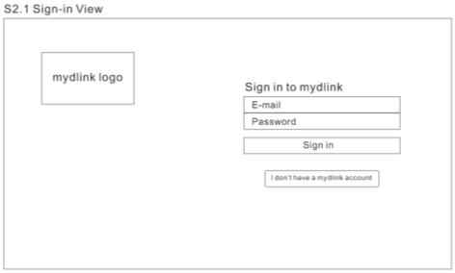
1
2
Old Design
Sing-in Page
1
New Design: (1) more content, (2) hide the sign in entrance
2
1

Slide 5
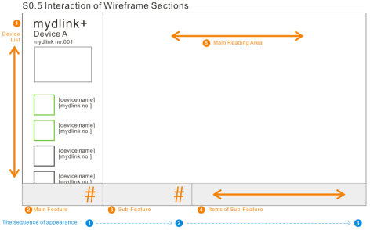
1
3
2
Old Design
Main Page
2
New Design: (1) open disposition, (2) show the feature as trigger , (3) fixed the location of all setting
1
3
2

Slide 6
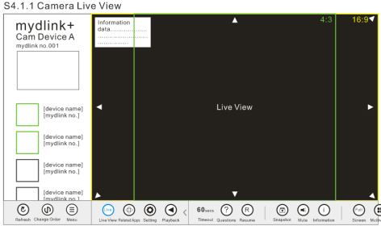
1
Old Design
Content Page
3
New Design: Put the Main feature on the same view
1

Slide 7
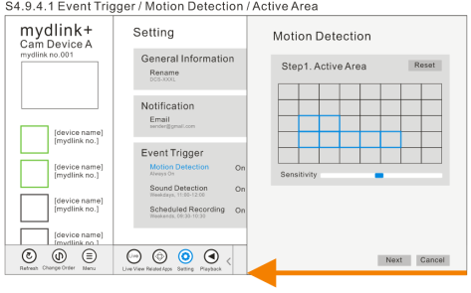
1
Old Design
Steps Page in Settings
4
New Design: Setting with visual steps
1

Slide 8
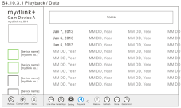
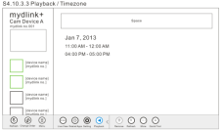
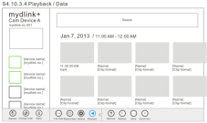
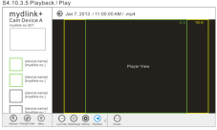
Date
Time-zone
Data
Play
Old Design
Data Picking
5
New Design: Only three level.
Month
Time-zone
Play

Slide 9
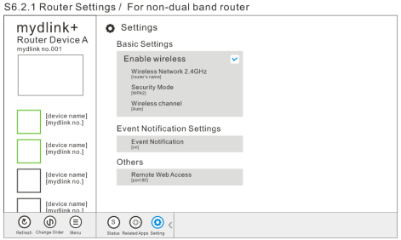
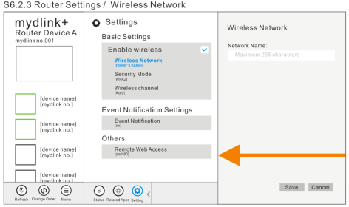
Old Design
The level of Settings
6
New Design: one main clean page + one or two detail level.

Slide 10
S0 Fly-out Style

Slide 11
S0.1 Fly-out Style 1
This type is used to communicate with shouting down all the communicative behavior outside this fly-out.
This type will also appear when user tap outside the Fly-out type 2 without saving.

Slide 12
S0.2 Fly-out Style 2
This type is used to communicate with a pop-up which grows from right side.
This type may or may not include decision making for user.
If there is decision in the fly-out and user press outside the fly-out, then present S0.1 to reminder user.
If there is no decision and user press outside the fly-out, then close the fly-out.
If the content is over one page in this type of fly-out, user could scroll up and down for reading.

Slide 13
S0.2.2 Fly-out Style 2
Following the behavior of S0.2.
If S0.2.2 is the subpage of S0.2 Tap this button will go back to S0.2, but If there is any setting has been changed but still not been saved, then present S0.1 to reminder user.

Slide 14
S0.3 Fly-out Style 3
This type is used to communicate with a pop-up which grows from up side.
This type may or may not include decision making for user.
This type is happened to: If user changes some setup but dose not leave the same section, presents this type to reminder user for apply setting or something else.

Slide 15
S0.4 Fly-out Style 4
Fly-out Style 4B
Fly-out Style 4A
This type could be an information teller or a decision maker.
This type is used to communicate with a pop-up which grows near to the last action.

Slide 16
S1 Launch View

Slide 17
S1 Launch view
S2.1
Feature: NONE.
Content area: defined by PP and VD.
Content area should include the entrance of S3.1 Special Features Available, the entrance shows and switch one figure and it’s description each time. The interaction animation is following the style in the windows 8 system by RD. Tap the entrance will go to S3.1.

Slide 18
S2 Sign in View

Slide 19
S2.1 Sign-in View
S3.2
1. The limitation or format of E-mail and Password are defined by RD.

Slide 20
S2.2.1 Emergency site information
S1

Slide 21
S2.2.2 Newer Version Needed
1. When a newer version of mydlink Lite is detected, popup a dialog to alert user.
If force upgrade, tap “OK” to exit app.
If not force upgrade, tap “OK” to continue using app.

Slide 22
S3 Device List

Slide 23
S3.1 Special Features Available
S1
Feature: NONE
One feature uses one or tow rows in one page to introduce, if content is longer then one page, please set the content in the next row. The number could put one or two full rows in one page. But please set a part of next row in the same page to prompt user to scroll left and right to read.

Slide 24
S3.2 Main Page
mydlink logo
S4.1.1/ S5.1/ S6.1.1
S3.4
S3.5
S3.6
Screen Line
Feature: Refresh.
The features are shown from middle which following the window 8 system definition.
Tap “Refresh”: refresh the condition of list.
Each device has online/offline changed status. Online first and Offline after. Default listing order: (1) Camera to Camera live view ( S4 ), (2) Router to router view ( S6 ), (3) NVR to NVR sign-in view ( S5 ), (4) Unknown device ( un-tap-able ); the difference of device is defined by VD.
Offline device: (1) different Visual Design with online device (2) disable (3) un-tap-able
There are two kinds of News: (1) Unread, (2) History, show these different kinds of News with different Visual Design.
There are three kinds of Apps: (1) Existing app, (2) Not Installed, (3) Coming Soon, show these different kinds of News with different Visual Design.
Screen Line

Slide 25
S3.3.1 Main Page/ Device/ No device under this account
S3.6.2a
Feature: Refresh.
Tap “Refresh”: refresh the condition of list.
Tap the section of “There is no device…”, go to S3.6.2a.

Slide 26
S3.3.2 Main Page/ Device/ Rename & Pin
S3.2
Screen Line
Features’ order: “Rename” [only happen in Camera Live View]→ “Pin to start” → other features are defined by device.
Tap “Rename”, go to S3-3-3
Tap “Pin to start” to create shortcut in main page, and:
If sign in, go to main page directly.
If not sign in, go to sign in page.

Slide 27
S3.3.3 Main Page/ Device/ Rename & Pin/ Rename [only happen in Camera Live View]
S3.2
Show the fly-out
Tap a Feature
Features’ order: “Rename” [only happen in Camera Live View]→ “Pin to start” → other features are defined by device.
If user tap “Done” button to save edit and close dialog up, if tap outside the fly-out to close fly-out without changing.
Input box: (a) Show current name in input box. (b) Tap input box to edit device name. (c) Show rename limit up the input box. (d) Can not input Chinese.

Slide 28
S3.4 Main Page/ News Content
S3.2
Feature: NONE
[News title] and [News content] are defined by PP.
[Date Time] is defined by RD.

Slide 29
S3.5 Main Page/ Apps’ content
S3.2
Feature: NONE
[App Name] and [App’s content] are defined by PP.
This page is made by web content.

Slide 30
S3.6.1 Main Page/ Settings
S3.6.1.1
S3.6.1.2
S3.6.2a
S3.6.3

Slide 31
S3.6.1.1 Main Page/ Settings/ Account Information
S3.6.1
Tap “sign out”: sign out user’s mydlink account.

Slide 32
S3.6.1.2 Main Page/ Settings
S3.6.1
If push notification is available, show a fly-out in style 1 with [title 1], [text 1] and two buttons: “Agree” and “Not agree” when APP is launched first time.
(1) “Agree” Button: Enable push notification, close popup. (2) “Not agree” Button: close popup.
If user enable event trigger settings and event triggered, show notification in notification bar and popup to remind in the fly-out style 1 with [title 2], [text 2] and two buttons: “OK” and “Live View”.
(1) “OK” Button: close popup. (2) “Live View”: go to see live view in the playback feature.
[title 1] Push notification available!
[text 1] mydlink plus would like to send you push notification when
event triggered with settings. (Ask for PP provide)
[title 2] Notification from mydlink plus
[text 2] [Motion Detected] at [17:00:00 JAN 7 2013] on [Camera Name] if SD card recordings is enabled, you can view the recording in camera playback. (Ask for PP provide)
* [text]: “We will send you notification when event was triggered. ( If event trigger settings for camera were enabled )” (Ask for PP provide)

Slide 33
S3.6.2a Main Page/ Settings/ Help
S3.6.1
S3.6.2b
Content is defined by PP.

Slide 34
S3.6.2b Main Page/ Settings/ Help/ Content
S3.6.2a
Content is defined by PP.

Slide 35
S3.6.3 Main Page/ Settings/ About
S3.6.1
Content is defined by PP.

Slide 36
S4 Camera

Slide 37
S4.1.1 Camera Live View
S3.2
mydlink logo
Timeout
words
Main Feature’s picture
S4.9.1
Settings
Screen Line
The order of features in camera is: Rename → Pin → Resume → Snapshot → Mute → Full Screen → Multiple View → Night Mode → View Type → Quality → Microphone → Information.
Show the live view and it’s features buttons. The features of live view is following the Specification of device.
<Double tap> the live view area on right side to switch full screen view. <Single tap>: PT controller Shoe/Hide( only appears when camera support ); <on showing>:auto fade out after 7 sec.<On entering live view>: PT controller appears and fade out after 5 sec.
Use ePTZ method to zoom live view ( S4.1.2 ).
Main features in the camera are: Playback ( S4.10.1 ) → Related Apps ( S4.8.1 ).
Tap “Playback”, go to S4.10.1; Tap “Related Apps”, go to S4.8.1.
“Timeout” Words: appears when relay countdown less than 60 seconds.

Slide 38
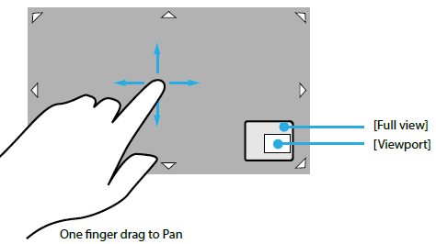
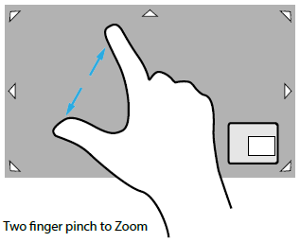
S4.1.2 ePTZ Activated
S3.2
[eptz feature]
1. ePTZ feature in live view :
One finger drag to pan.
Two finger pinch to zoom.
Show full/port view when user single tap view and it is in zoom out status.

Slide 39
S4.2.1 View Type
S3.2
Option’s picture
The order of features in camera is the same with S4.1.1 camera live view.
Tap “View Type” Button will show or close the fly-out.
Tap one of the options will switch to one type of the View and close the fly-out.
Tap outside the fly-out will close the fly-out.
Show the [option’s name] and it’s picture in the option’s section.
Open a fly-out in type 4 to switch view mode which depends on mount type as below:
Ceiling ( Default ): 1O / 1R / 2P / 1O3R / 4R
Wall: 1O / 1R / 1P2R / 1O3R / 4R
Desktop:1O / 1R / 2P / 1O3R / 4R

Slide 40
S4.2.2 Quality
S3.2
Option’s picture
The order of features in camera is the same with S4.1.1 camera live view.
Tap “Quality” Button will show or close the fly-out.
Tap one of the options will switch to one type of the View and close the fly-out.
Tap outside the fly-out will close the fly-out.
Open a fly-out in type 4 to switch quality mode which depends on demand.
There are three options in the Quality, and the order of the options from top to down is: 240→480→HD, and Default of quality is 240.
Show the [option’s name] in the option’s section only.

Slide 41
S4.2.3 Night View
S3.2
Option’s picture
The order of features in camera is the same with S4.1.1 camera live view.
Tap “Night View” Button will show or close the fly-out.
Tap one of the options will switch to one type of the View and close the fly-out.
Tap outside the fly-out will close the fly-out.
There are three kinds of Night Mode, the order from up to down is: Night → Day → Auto.

Slide 42
S4.3 Lost Video Stream
From >> Live View ( S4.1.1 ) when connect was lost.
Tap “Abort” Button: Abort and return.
Tap “Try Again” Button: Retry connect to keep connect or re-show lost page.
[Title]: “Connection was lost”(Ask PP provides)
[Content]: “The video stream from your device was lost. Please try again.”(Ask PP provides)

Slide 43
S4.4.1 Two way audio / Press and hold to speak (1/4)
S3.2
The order of features in camera is the same with S4.1.1 camera live view.
The features of 2 Way Audio are shown in the next page.

Slide 44
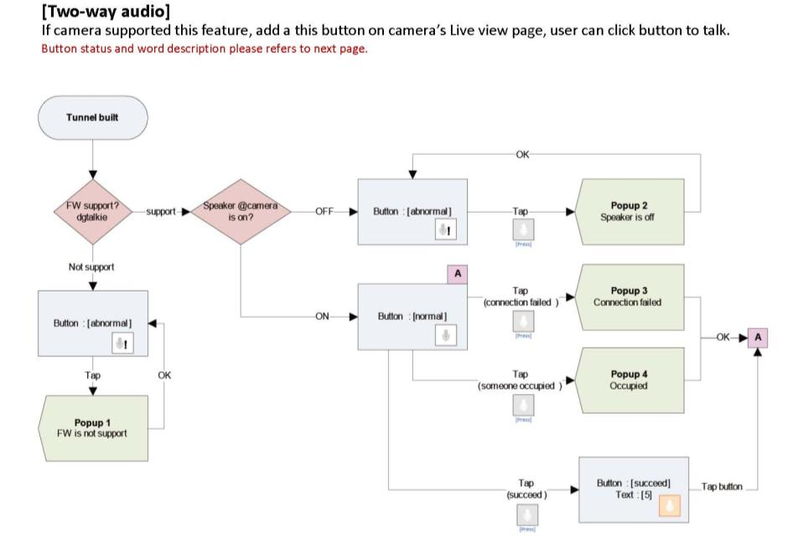
S4.4.1 Two way audio / Press and hold to speak (2/4)

Slide 45
S4.4.1 Two way audio / Press and hold to speak (3/4)
This page is the Reminding type.
The words and icons are shown in the next page.

Slide 46
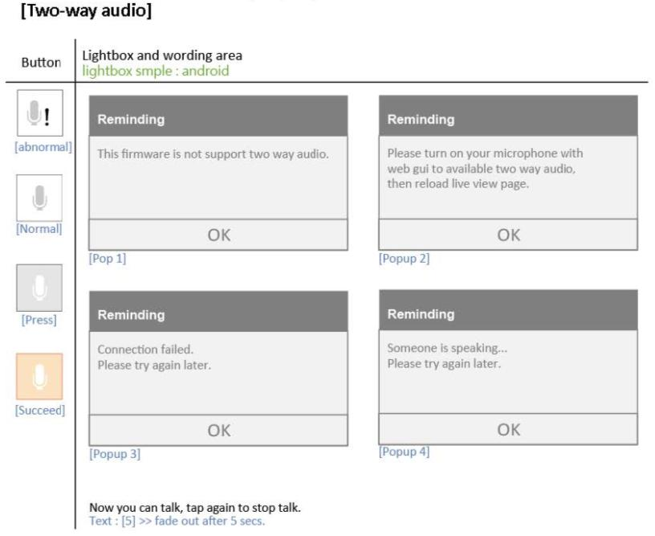
S4.4.1 Two way audio / Press and hold to speak (4/4)

Slide 47
S4.5.1 Single camera live view
The order of features in camera is the same with S4.1.1 camera live view.
Switch to Camera Live View: (1) Double tap the live view area to switch to Camera live view ( S4 ), (2) Tap Screen button to Camera live view ( S4 ), (3) Fade in the status and title bar after any tap
Fade out the status and title bar after 5 seconds of no tapping automatically.
The method of all the features are the same with the normal size screen.
The behavior is the same with live view.

Slide 48
S4.5.2 Single camera live view / Feature ( EX: View Mode )
The order of features in camera is the same with S4.1.1 camera live view.
The behavior is the same with live view.

Slide 49
S4.5.3 Single camera live view / Feature ( EX: Two way audio )
The order of features in camera is the same with S4.1.1 camera live view.
The behavior is the same with live view.

Slide 50
S4.7 Multi-cam view
S3.2
Main
Feature’s picture
Features’ order: Signal-cam View → Mute → Information.
Tap “Multi-cam View” Button in the feature list will show this page. Show all the camera’s view on screen and add main feature’s picture on the right of last view.
Feature’s Action: (1) Tap “Signal-cam View” Button in the feature list will go back to the live view. (2) Tap “Mute” Button to close/open the audio to all the views. (3) Tap “Information” Button to close/ open the information to all the views.
The default of information is close.
Play the original view before Multi-view is set in the top-and-most left location.
Countdown 60secs is only for original view. Show the words ‘Please tap this view if you want to resume’ in the center of original view. User could resume the original view by tapping the view.
Play the video and stop original one when tapping different video. ( Play one video one time )
If camera connection is failed, user could tap it’s view again to re-connection.

Slide 51
S4.8 Camera/ Related Apps
S3.2
mydlink logo
Main feature’s picture
Screen Line
Features: NONE.
Tap the “Related Apps” button will show this page.
Current main feature’s pictures: Live View → Playback.
There are three kinds of app’s icon type: Existing app, Not Installed, Coming Soon.
Tap one of apps will show the apps’ content page ( the same with S3.5)

Slide 52
S4.9.1 Setting
Example from S4.1.1
S4.9.2
S4.9.3
S4.9.4
S4.9.7
“Submit” button:
Default: hide.
Show: when any setting has been changed. Push “Submit” button: saving change in the setting and close the fly-out.
If tap outside the fly-out:
Without change, close the fly-out without saving changes.
With change, show a notice fly-out.
Notice fly-out:
In the fly-out style 1. with [Title], [Text], and “Yes” and “No” button.
Tap “No” button, go back to original page. Tap ”Yes” button, close the fly-out without saving.
[Title]: Reminding
[Text]: Some of setting are changed, please go back to the setting page and press the Submit button. Do you want to abandon your settings?

Slide 53
S4.9.2 Settings/ General Information/ Rename
S4.9.1
If tap outside the fly-out:
Without change, close the fly-out without saving changes.
With change, show a notice fly-out.
Notice fly-out:
In the fly-out style 1. with [Title], [Text], and “Yes” and “No” button.
Tap “No” button, go back to original page. Tap ”Yes” button, close the fly-out without saving.
[Title]: Reminding
[Text]: Some of setting are changed, please go back to the setting page and press the Submit button. Do you want to abandon your settings?

Slide 54
S4.9.3 Settings/ Email Notification
S4.9.1
If tap outside the fly-out:
Without change, close the fly-out without saving changes.
With change, show a notice fly-out.
Notice fly-out:
In the fly-out style 1. with [Title], [Text], and “Yes” and “No” button.
Tap “No” button, go back to original page. Tap ”Yes” button, close the fly-out without saving.
[Title]: Reminding
[Text]: Some of setting are changed, please go back to the setting page and press the Submit button. Do you want to abandon your settings?

Slide 55
S4.9.4 Settings/ Event Trigger
S4.9.1
S4.9.4a
S4.9.5a
S4.9.6
If the device support PIR, and the user turn on the Motion Detection on portal, it will show “Motion Detection with PIR”.
If turn on the Motion Detection, go to S4.9.4a directly.
If turn on the Sound Detection, go to S4.9.5a directly.
If turn on the Schedule Recording, go to S4.9.6 directly.
If tap outside the fly-out:
Without change, close the fly-out without saving changes.
With change, show a notice fly-out.
Notice fly-out:
In the fly-out style 1. with [Title], [Text], and “Yes” and “No” button.
Tap “No” button, go back to original page. Tap ”Yes” button, close the fly-out without saving.
[Title]: Reminding
[Text]: Some of setting are changed, please go back to the setting page and press the Submit button. Do you want to abandon your settings?

Slide 56
S4.9.4a Settings/ Event Trigger/ Motion Detection/ Active Area
S4.9.1
S4.9.4b
If tap “Reset active area”, clean the setting of active area and sensitivity.
“Schedule” is tap-able. “Recording with notification” is un-tap-able and gray out. VD could highlight the schedule with visual design.
If tap “Back” button or outside the fly-out:
Without change, close the fly-out without saving changes.
With change, show a notice fly-out.
Notice fly-out:
In the fly-out style 1. with [Title], [Text], and “Yes” and “No” button.
Tap “No” button, go back to original page. Tap ”Yes” button, close the fly-out without saving.
[Title]: Reminding
[Text]: Some of setting are changed, please go back to the setting page and press the Submit button. Do you want to abandon your settings?

Slide 57
S4.9.4b Settings / Event Trigger / Motion Detection / Schedule
S4.9.1
S4.9.4c
Fold Weekdays and Time if user taps “Keep detecting continuously”
“Recording with notification” is tap-able. “Active Area” is un-tap-able and gray out. VD could highlight the schedule with visual design.
If tap “Back” button or outside the fly-out:
Without change, close the fly-out without saving changes.
With change, show a notice fly-out.
Notice fly-out:
In the fly-out style 1. with [Title], [Text], and “Yes” and “No” button.
Tap “No” button, go back to original page. Tap ”Yes” button, close the fly-out without saving.
[Title]: Reminding
[Text]: Some of setting are changed, please go back to the setting page and press the Submit button. Do you want to abandon your settings?

Slide 58
S4.9.4c Settings/ Event Trigger/ Motion Detection / Recording with notification
S4.9.1
“Schedule” and “Active Area” are both un-tap-able and gray out. VD could highlight the schedule with visual design.
If tap outside the fly-out:
Without change, close the fly-out without saving changes.
With change, show a notice fly-out.
Notice fly-out:
In the fly-out style 1. with [Title], [Text], and “Yes” and “No” button.
Tap “No” button, go back to original page. Tap ”Yes” button, close the fly-out without saving.
[Title]: Reminding
[Text]: Some of setting are changed, please go back to the setting page and press the Submit button. Do you want to abandon your settings?

Slide 59
S4.9.5a Settings/ Event Trigger/ Sound Detection/ Sound Area
S4.9.1
S4.9.5b
User could set up the sound value by slipping the “Ball” button
“Schedule” is tap-able. “Recording with notification” is un-tap-able and gray out. VD could highlight the schedule with visual design.
If tap “Back” button or outside the fly-out:
Without change, close the fly-out without saving changes.
With change, show a notice fly-out.
Notice fly-out:
In the fly-out style 1. with [Title], [Text], and “Yes” and “No” button.
Tap “No” button, go back to original page. Tap ”Yes” button, close the fly-out without saving.
[Title]: Reminding
[Text]: Some of setting are changed, please go back to the setting page and press the Submit button. Do you want to abandon your settings?

Slide 60
S4.9.5b Settings/ Event Trigger/ Sound Detection/ Schedule
S4.9.1
S4.9.5c
Fold Weekdays and Time if user taps “Keep detecting continuously”
“Recording with notification” is tap-able. “Active Area” is un-tap-able and gray out. VD could highlight the schedule with visual design.
If tap “Back” button or outside the fly-out:
Without change, close the fly-out without saving changes.
With change, show a notice fly-out.
Notice fly-out:
In the fly-out style 1. with [Title], [Text], and “Yes” and “No” button.
Tap “No” button, go back to original page. Tap ”Yes” button, close the fly-out without saving.
[Title]: Reminding
[Text]: Some of setting are changed, please go back to the setting page and press the Submit button. Do you want to abandon your settings?

Slide 61
S4.9.5c Settings/ Event Trigger/ Sound Detection/ Recording with notification
S4.9.1
“Schedule” and “Active Area” are both un-tap-able and gray out. VD could highlight the schedule with visual design.
If tap outside the fly-out:
Without change, close the fly-out without saving changes.
With change, show a notice fly-out.
Notice fly-out:
In the fly-out style 1. with [Title], [Text], and “Yes” and “No” button.
Tap “No” button, go back to original page. Tap ”Yes” button, close the fly-out without saving.
[Title]: Reminding
[Text]: Some of setting are changed, please go back to the setting page and press the Submit button. Do you want to abandon your settings?

Slide 62
S4.9.6 Settings/ Event Trigger/ Schedule Recording
S4.9.1
Fold Weekdays and Time if user taps “Keep detecting continuously”
If tap outside the fly-out:
Without change, close the fly-out without saving changes.
With change, show a notice fly-out.
Notice fly-out:
In the fly-out style 1. with [Title], [Text], and “Yes” and “No” button.
Tap “No” button, go back to original page. Tap ”Yes” button, close the fly-out without saving.
[Title]: Reminding
[Text]: Some of setting are changed, please go back to the setting page and press the Submit button. Do you want to abandon your settings?

Slide 63
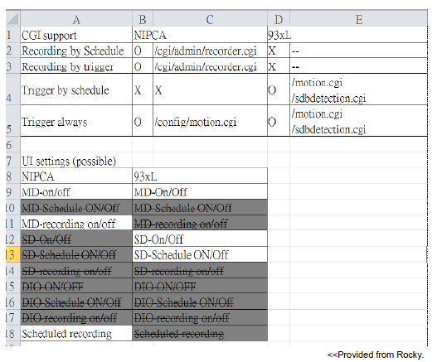
<Note> Event trigger Settings solution for NIPCA and 93XL camera

Slide 64
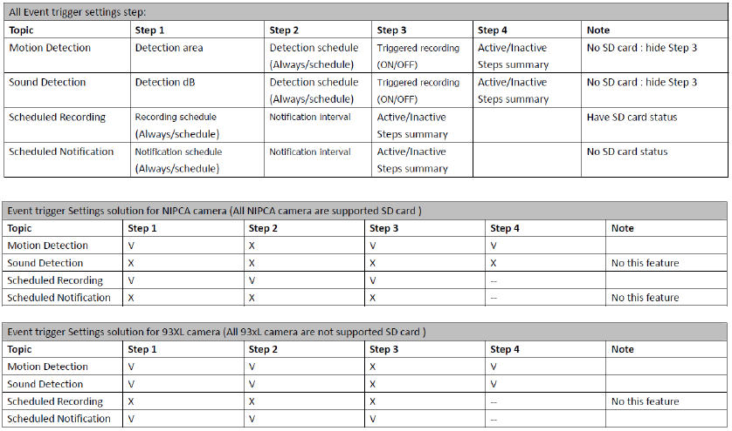
<Note> Event trigger Settings solution for NIPCA and 93XL camera

Slide 65
S4.9.7 Extender Mode
S4.9.1
Wireless network: Input box, show the Wireless name of the camera. If the SSID retrieved from the camera is empty, pre-loaded the wireless name that the camera is connected to into the field, Click to input Wireless name and it can the same as the existing Wireless name, Alphanumeric,1-32 characters.(This limitation refers to PRD, any question please contact PP.)
Security mode: Default: WPA/WPA2, Drop down menu, The Security Mode is not changeable.
Wireless password: Default: Input box, show the Wireless password of the camera. If the SSID retrieved from the camera is empty, pre-loaded the wireless password that the camera is connected to into the field. Click to input password for wireless network. If the field is empty, a warning is shown below the field to tell the user that the network is open and anyone can connect to it. Character limitation:6-30 characters. (This limitation refers to PRD, any question please contact PP.)
Retype password: Input box, Retype to confirm the password. If the two passwords don’t match, show error message under the field. Default: show the wireless password of the camera. If the SSID retrieved from the camera is empty, pre-loaded the wireless password that the camera is connected to into the field.

Slide 66
S4.9.7 Extender Mode (continue)
S4.9.1
If tap outside the fly-out:
Without change, close the fly-out without saving changes.
With change, show a notice fly-out.
Notice fly-out:
In the fly-out style 1. with [Title], [Text], and “Yes” and “No” button.
Tap “No” button, go back to original page. Tap ”Yes” button, close the fly-out without saving.
[Title]: Reminding
[Text]: Some of setting are changed, please go back to the setting page and press the Submit button. Do you want to abandon your settings?

Slide 67
S4.10.1 Playback / Entrance
There are four situations after tap Playback: (1) Scenario 1: Unable to access our SD card (2) Scenario 2: Need to format SD card first (3) Scenario 3: When there is no clip in Playback (4) Scenario 4: Playback: Date
Tap device:
Tap “OK”: close popup then follow normal flow. Don’t remind this device again unless user sign in again or refresh.
Latest FW
or not?
No
S4.10.1
Yes
Normal flow
[Title]: “New firmware available” ( Ask PP Provide )
[Content]: “A new firmware is available is available for your device. Go to mydlink.com.tw to upgrade your firmware and ensure you have access to the latest features.” ( Ask PP Provide )

Slide 68
S4.10.2 Playback / Scenario
Screen Line
Scenario 1: Unable to access our SD card
Feature: “Refresh”
Tap “Refresh” button: re-access SD card.
Scenario 2: Need to format SD card first
Feature: “Format”
Tap “Format” button: format SD card
[Title]: ” Unable to access your micro SD card. ” ( Ask PP Provide )
[Content]: “Please make sure that the micro SD card is properly inserted into the Cloud Camera. Then click Refresh to try again.” ( Ask PP Provide )
[Title] means: This micro SD card is not format yet. ( Ask PP Provide )
[Content] means: Please format micro SD card first. ( Ask PP Provide )

Slide 69
S4.10.2 Playback / Scenario
Screen Line
Scenario 3: When there is no clip in Playback
Feature: “Refresh”
Tap “Refresh” button: Reload playback.
Scenario 4a: Playback: Date: for APPRO
Feature: “Refresh”
Tap “Refresh” button: Reload playback.
[Title]: ”No Video Clip” ( Ask PP Provide )
[Content]: “Please tap Refresh to reload it.” ( Ask PP Provide )
[Title]: ”Looking for video clip” ( Ask PP Provide )
[Content]: “Please tap Quick Find” ( Ask PP Provide )

Slide 70
S4.10.3.1 Playback / Scenario 4b for NIPICA / Time-zone
S4.10.3.3
Screen Line
Feature’s Order: Quick Find → Refresh
Tap the feature: Quick Find: go to S4.10.3.2

Slide 71
S4.10.3.2 Playback / Quick Find
S4.10.3.4
Only show the options with content in the Quick Find picker.
Press outside the Quick Find, back to 4.10.3.1.

Slide 72
S4.10.3.3 Playback / Month
1. Pick a Year/Month item will move to the Year/month category.

Slide 73
S4.10.3.4 Playback / Data
S4.10.3.1
S4.10.3.2
Feature’s order: Refresh → Remove(default: hide)
Tap ”Refresh” Button: Reload playback.
[Clip format] and [Name] are defined by RD.
The clips are presented from new to old.
Remove feature: see S4.5.10.1

Slide 74
S4.10.3.5 Playback / Play
S4.10.3.4
Other clips
The order of features in camera is the same with S4.1.1 camera live view. And add a feature “Remove” in the most left of list.
Tap remove button, show a fly-out in style 1 with [text 1], and “Yes” and ”No” buttons.
If tap “Yes”, remove this clip and go back to S4.10.3.4; If tap “No”, go back to S4.10.3.5.
If remove fail, show the fly-out 1 with [text 2] and an ”OK” button.
If recording type unsupported toolbar, please skip the description about tool bar.
The tool bar is set up under the video view independently ( by RD Eric )
The tool bar and the function of full screen are defined by iOS. ( by RD Eric )
[text 1]: “Do you really want to remove clips you select?”( Ask PP Provide )
[text 2]: “One or more clips cannot be remove, it might be the file is recording.” ( Ask PP Provide )

Slide 75
S4.10.4.1 Playback / Settings
S4.10.4.2
The picture of remaining space
Text content default: hide.
Some device cannot format SD card when recording is enable, if the case happen, disable SD card format button and show the [Text].
[Text]: ”The SD card can not be formatted when recording is enable, please stop recording with computer or tablet first.” ( Ask PP Provide )

Slide 76
S4.10.4.2 Playback / Settings / When SD card is Full
S4.10.4.1
The picture of remaining space
If tap “Back” button or outside the fly-out, close the fly-out and saving changes.
Text:
Default is hide.
Tick continue and overwrite, show [text 1].
Tick stop recording, show [text 2].
[text 1]: “Continue recording and overwrite the oldest video. “( Ask PP Provide )
[text 2]: “Stop recording and notify me if I enabled E-mail notifications with PC or tablet. “( Ask PP Provide )

Slide 77
S4.10.5.1 Playback / Clip / Remove
S4.10.3.1
S4.10.3.2
Feature’s order: Refresh → Remove(default: hide)
Pick clips by dragging down.
After picking clips, show the “Remove” button.
After tapping the “Remove” button, show the fly-out 1 with [text 1] and “Yes” and “No” buttons.
If remove fail, show the fly-out 1 with [text 2] and an ”OK” button.
[Clip format] and [Name] are defined by RD.
The clips are presented from new to old.
[text 1]: “Do you really want to remove clips you select?”( Ask PP Provide )
[text 2]: “One or more clips cannot be remove, it might be the file is recording.” ( Ask PP Provide )

Slide 78
S5 NVR

Slide 79
S5.1 NVR sign-in view
S5.2.1
If the device tapped by user is NVR, show this page.
The limitation or format of E-mail and Password are defined by RD.

Slide 80
S5.2.1 Connected cameras view / List
mydlink logo
S3.2
Feature: NONE
Show all the items in the categories of Connected Cameras and Related Apps.
There are three kinds of related app’s icon type: “Existing app”, “Not Installed”, “Coming Soon”.

Slide 81
S5.2.2 Connected cameras view / Live view
S5.2.1
Other connected camera view
Features: the same with camera.

Slide 82
S5.2.3 Connected cameras view / Related Apps
S3.2
mydlink logo
Main feature’s picture
Screen Line
Features: NONE.
Tap the “Related Apps” button will show this page.
Current main feature’s pictures: Live View → Playback.
There are three kinds of app’s icon type: Existing app, Not Installed, Coming Soon.
Tap one of apps will show the apps’ content page ( the same with S3.5 )

Slide 83
S6 Router

Slide 84
S6.1.1 Router View / non-dual band router
S3.2
Features’ order: Refresh → Reboot.
Tap “Refresh” button: refresh both values of Upload and Download .
If Tap “Reboot” without change, show a fly-out in style 1 with [title0], [text0], “Yes” button, “No” button.
If Tap “Reboot” when anything changed, show a fly-out in style 1 with [title1], [text1], “Yes” button, “No” button.
If Tap “Reboot” with Suspect list, show a fly-out in style 1 with [title2], [text2], “Yes” button, “No” button.
If Tap “Reboot" with settings and Connection List/Suspect List changed, show a fly-out in style 1 with [title3], [text3], “Yes” and “No” buttons.
If Tap “Back” with changing settings, show a fly-out in style 1 with [title4], [text4], “Yes” button, “No” button.
The detail of No. 3-7 see S6.1.2.
Connection devices: (1) Unblock (2) Block. User could block or unblock it with switcher and then system will auto save it.
There are three kinds of app’s icon type: Existing app, Not Installed, Coming Soon.
Show the text ”No Device” in the list of connection/ suspected/ related apps; Show all the devices or Apps in each list.

Slide 85
S6.1.2 Router View / dual band router
S3.2
The same with S6.1.1
[title0]: “Reminding”[text0]:“It will take 80 seconds to reboot the router. Do you want to continue?“(Ask PP Provide )
[title1]: “Reminding”[text1]:“Your setting changes have not applied yet and will be cleared. It will take 60 seconds to reboot the router. Do you want to continue?“(Ask PP Provide )
[title2]: “Reminding”[text2]:“The suspect list will be cleared. It will take 60 seconds to reboot the router. Do you want to continue?“(Ask PP Provide )
[title3]: “Reminding”[text3]:“Your setting changes have not applied yet and will be cleared. The suspect list will be cleared. It will take 60 seconds to reboot the router. Do you want to continue?“(Ask PP Provide )
[title4]: “Reminding”[text4]:“Your setting changes have not applied yet and will be cleared. Do you want to continue?“(Ask PP Provide )

Slide 86
S6.1.3 Router View / Tap device in the connected device
S6.1.1/ S6.1.2
Feature: NONE.
User could use the switcher to block/ unblock this device.
Notes:
Tap online device

Slide 87
S6.2.1 Router Settings / For non-dual band router
S6.2.3
S6.2.4
S6.2.5
“Submit” button:
Default: hide.
Show: when any setting has been changed. Push “Submit” button: saving change in the setting and close the fly-out.
If tap outside the fly-out:
Without change, close the fly-out without saving changes.
With change, show a notice fly-out.
Notice fly-out:
In the fly-out style 1. with [Title], [Text], and “OK” and “Give up” button.
After push the “OK” button, go to the setting page with the submit button. Tap ”give up” button, close the fly-out without saving.
[Title]: Reminding [Text]: some of setting are changed, please go back to the setting page and press the Submit button.

Slide 88
S6.2.2 Router Settings / For dual band router
S6.2.3
S6.2.4
S6.2.5
The behavior is the same with S6.2.1.

Slide 89
S6.2.3 Router Settings / Enable wireless
S6.2.1 / S6.2.2
S6.2.3a
S6.2.3b
S6.2.3c
If tap outside the fly-out:
Without change, close the fly-out without saving changes.
With change, go to S6.2.1 with a notice fly-out.

Slide 90
S6.2.3a Router Settings / Enable wireless / Wireless Network 2.4GHz
S6.2.3
If tap outside the fly-out:
Without change, close the fly-out without saving changes.
With change, go to S6.2.1 with a notice fly-out.

Slide 91
S6.2.3b Router Settings / Enable wireless / Security Mode
S6.2.3
If user choose Disable, the Wireless password Section will be hided.
If user choose WEP, the word ” 5 or 13 characters “ will be showed in the Network Key.
If user choose WPA/WPA2, the word ” 8~63 characters “ will be showed in the Network Key.
If tap outside the fly-out:
Without change, close the fly-out without saving changes.
With change, go to S6.2.1 with a notice fly-out.

Slide 92
S6.2.3c Router Settings / Enable wireless / Wireless channel
S6.2.3
Options: Auto, 1, 2, …, 13
If tap outside the fly-out:
Without change, close the fly-out without saving changes.
With change, go to S6.2.1 with a notice fly-out.

Slide 93
S6.2.4 Router Settings / Event Notification
S6.2.1 / S6.2.2
S6.2.4.1/ S6.2.4.1a
If tap outside the fly-out:
Without change, close the fly-out without saving changes.
With change, go to S6.2.1 with a notice fly-out.

Slide 94
S6.2.4.1 Router Settings / Event Notification / Tap Email
S6.2.4
S6.2.4.2
S6.2.4.3/ S6.2.4.4
If tap outside the fly-out:
Without change, close the fly-out without saving changes.
With change, go to S6.2.1 with a notice fly-out.
[Text]: The notification will be sent to your mydlink registered e-mail address.

Slide 95
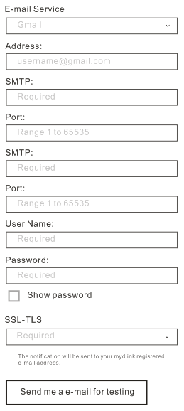
S6.2.4.1a Router Settings / Event Notification / Tap Email/ when E-mail Service is Other
S6.2.4
Other
the behavior is the same with S6.2.4.1.
S6.2.4.3/ S6.2.4.4

Slide 96
S6.2.4.2 Router Settings / Event Notification / Tap Email / Tap to select E-mail service
S6.2.4
S6.2.4.1/ S6.2.4.1a
If choose Other, go to S6.2.4.2a; else go to S6.2.4.2.
If tap outside the fly-out:
Without change, close the fly-out without saving changes.
With change, go to S6.2.1 with a notice fly-out.

Slide 97
S6.2.4.3 Router Settings / Event Notification / Warning when tapping Email
S6.2.4
If tap “Send me a e-mail for testing” without entering E-mail value, show the Wording fly-out . This fly-out will automatically fade out after 3 seconds or any tap.
If tap outside the “E-mail” fly-out:
Without change, close the fly-out without saving changes.
With change, go to S6.2.1 with a notice fly-out.
[Text]: Please fulfill the e-mail setting for sending notification.

Slide 98
S6.2.4.4 Router Settings / Event Notification / Tap Email / Test
S6.2.4
Tap “Send me a e-mail for testing” button in S6.2.4.1, it would try to access and send an test e-mail from the input data.
If successful, it popup a successful dialog with [Title 1] and [content 1]. This fly-out will automatically fade out after 5 seconds or any tap.
If failed, it popup a failed dialog [Title 2] and [content 2]. This fly-out will automatically fade out after 5 seconds or any tap.
If tap outside the “E-mail” fly-out:
Without change, close the fly-out without saving changes.
With change, go to S6.2.1 with a notice fly-out.
[Title 1]: “Test Successfully”; [content 1]: “A test notification has been sent to your mydlink registered e-mail address. If you do not receive the e-mail notification, check your spam folder, or try sending notifications to another e-mail account.”
[Title 2]:” Test Failed”; [content 2]:” The test notification email could not be sent; Please check to make sure your account settings are correct, or use different e-mail address.”

Slide 99
S6.2.5 Router Settings / Remote Web Access
S6.2.1 / S6.2.2
S6.2.5.1

Slide 100
S6.2.5.1 Router Settings / Remote Web Access / Port
S6.2.5

